Slide 1

Memory Reference Instruction

Slide 2

Memory-Reference Instructions
The instruction format consist with
12 bit address
3 bit OPCODE
1 bit mode
From 3*8 Decoder the memory reference instruction are symbolized from D0 to D7.

Slide 3
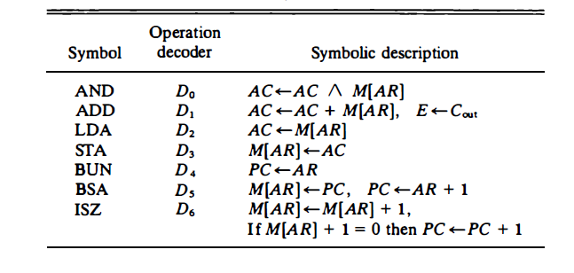

Slide 4

AND to AC
This is an instruction that performs the AND logic operation on pairs of bits in AC and the memory word specified by the effective address.
The result of the operation is transferred to AC . The microoperations that execute this instruction are:
D0T4: DR <- M [AR]
D0T5: AC <- AC /\ DR, SC <--- 0
The control function for this instruction uses the operation decoder D0 since this output of the decoder is active when the instruction has an AND operation whose binary code value is 000

Slide 5

Two timing signals are needed to execute the instruction. The clock transition associated with timing signal T4 transfers the operand from memory into DR .
The clock transition associated with the next timing signal T5 transfers to AC the result of the AND logic operation between the contents of DR and AC. The same clock transition clears SC to 0, transferring control to timing signal T0 to start a new instruction cycle.

Slide 6

ADD to AC
This instruction adds the content of the memory word specified by the effective address to the value of AC . The sum is transferred into AC and the output carry C,., is transferred to the E (extended accumulator) flip-flop. The microoperations needed to execute this instruction are
DIT,: DR <--- M [AR]
D1T5: AC <--- AC + DR, E <--- C,.,, SC <--- 0

Slide 7

ADD to AC
The same two timing signals, T, and T5, are used again but with operation decoder D1 instead of D0, which was used for the AND instruction. After the instruction is fetched from memory and decoded, only one output of the operation decoder will be active, and that output determines the sequence of rnicrooperations that the control follows during the execution of a memory-reference instruction

Slide 8

LDA: Load to AC
This instruction transfers the memory word specified by the effective address to AC . The rnicrooperations needed to execute this instruction are
D2T4: DR <--- M [AR]
D2T5: AC <--- DR, SC <--- 0

Slide 9

STA: Store AC
This instruction stores the content of AC into the memory word specified by the effective address. Since the output of AC is applied to the bus and the data input of memory is connected to the bus, we can execute this instruction with one microoperation:
D3T4: M [AR] <--AC, SC <--0

Slide 10

BUN: Branch Unconditionally
This instruction transfers the program to the instruction specified by the
effective address. Remember that PC holds the address of the instruction to be read from memory in the next instruction cycle. PC is incremented at time T1 to prepare it for the address of the next instruction in the program sequence.
The BUN instruction allows the programmer to specify an instruction out of
sequence and we say that the program branches (or jumps) unconditionally.
The instruction is executed with one microoperation:
D4T4: PC <--AR, SC <--0

Slide 11

BSA: Branch and Save Return Address
This instruction is useful for branching to a portion of the program called a subroutine or procedure. When executed, the BSA instruction stores the address of the next instruction in sequence (which is available in PC) into a memory location specified by the effective address. The effective address plus one is then transferred to PC to serve as the address of the first instruction in the subroutine. This operation was specified in Table 5-4 with the following register transfer:
[AR] <--PC, PC <--AR + I

Slide 12

ISZ: Increment and Skip if Zero
This instruction increments the word specified by the effective address, and if the incremented value is equal to 0, PC is incremented by 1. The programmer usually stores a negative number (in 2's complement) in the memory word. As this negative number is repeatedly incremented by one, it eventually reaches the value of zero. At that time PC is incremented by one in order to skip the next instruction in the program.

Slide 13
ISZ: Increment and Skip if Zero
Since it is not possible to increment a word inside the memory, it is
necessary to read the word into DR, increment DR, and store the word back into memory. This is done with the following sequence of microoperations:
D6T4: DR <--M [AR]
D6T5: DR <--DR + 1
D,T,: M [AR] <--DR, if (DR = 0) then (PC <--PC + 1), SC <--0

